Slide 1
Install the Prereqs
Install Node.js at nodejs.org/en/downloads
If you have a Mac “brew install node” from the CLI
Install a text editor like Visual Studio Code (works on PC, Mac, or Linux) at code.visualstudio.com
Any text editor you already have will work

Slide 2
With Cognitive Services
Determining your GoT House
Justine Cocchi
@JustineCocchi

Slide 3

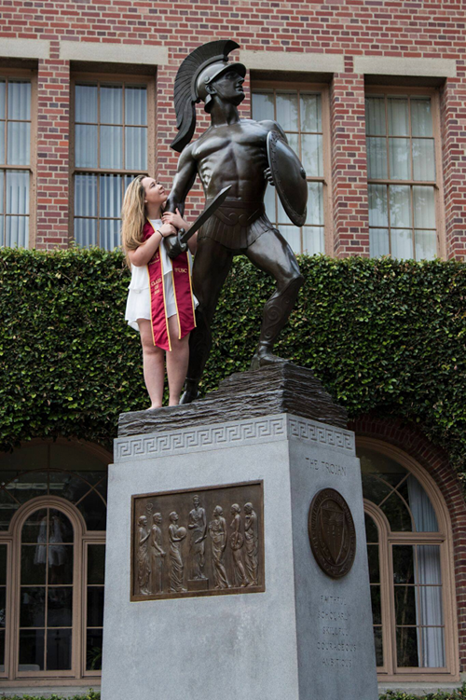

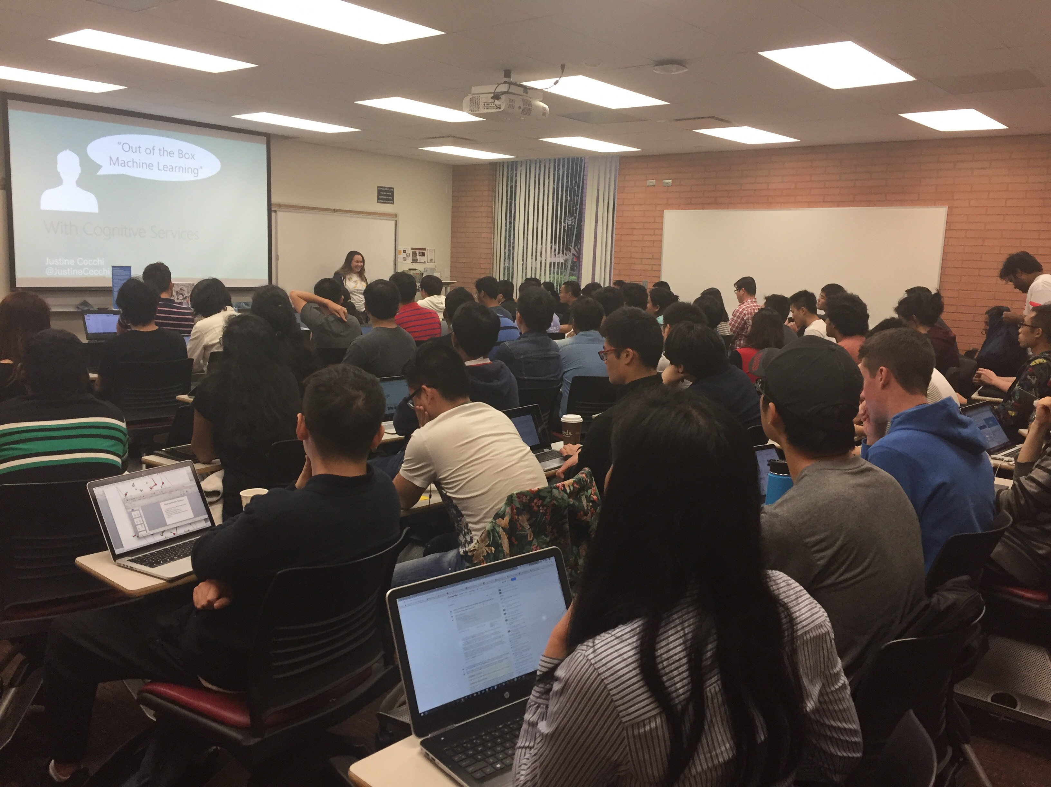
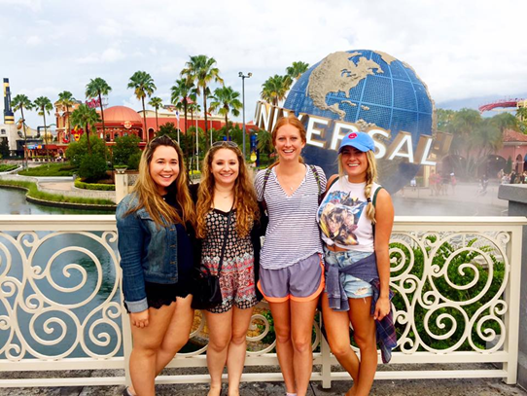
About Justine
B.S. Computer Science and Business Administration from USC
Microsoft for 1.5 years
Bike rides, comedy shows, and Netflix

Slide 4

Agenda
Overview of Cognitive Services APIs
Hands on Workshop

Slide 5
What are Cognitive Services?
What are Cognitive Services?
Prebuilt machine learning models to quickly add context and deeper understanding to your apps

Slide 6
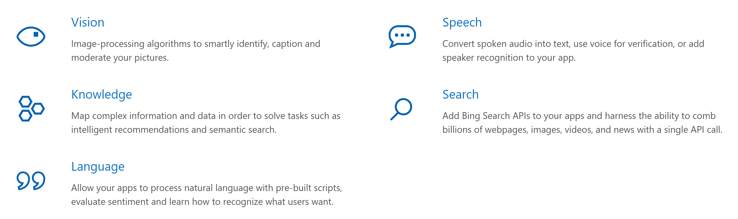
Cognitive Services
microsoft.com/cognitive
Notes:
Go to Microsoft.com/cognitive → show Emotion API Reference

Slide 7


Slide 8
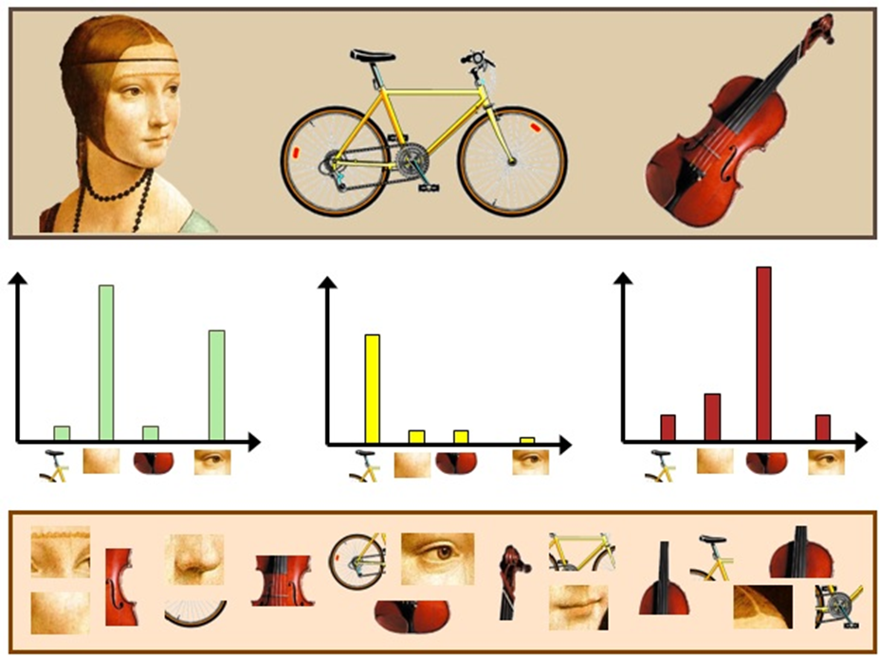















How?
Convolutional Neural Networks (Deep Learning)

Slide 9



“But I’m not a data scientist…”

Slide 10

Why?
Easy, flexible and tested

Slide 11

Vision APIs

Slide 12
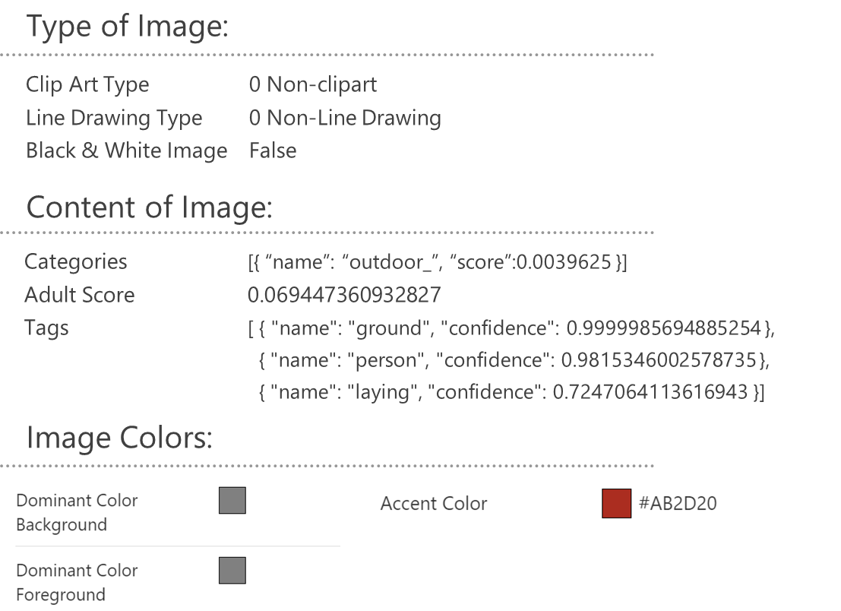

Computer Vision – Analyze Image
Notes:
This feature returns information about visual content found in an image.
As you can see here we have included type, content, and colors but there are a few more classifiers on the site

Slide 13

JSON:
{
"language": "en",
"textAngle": -1.8000000000000336,
"orientation": "Up",
"regions": [
{
"boundingBox": "137,68,261,274",
"lines": [
{
"boundingBox": "167,68,183,35",
"words": [
{
"boundingBox": "167,75,41,28",
"text": "OF"
},
{
"boundingBox": "223,72,56,25",
"text": "THE"
},
{
"boundingBox": "294,68,56,29",
"text": “DAY"
}
]
};
. . .
Computer Vision - OCR
TEXT:
OF THE DAY
NEW
BACON -INGS
- COMES WITH BACON
Notes:
Optical character recognition (OCR) detects the text in an image and extracts the recognized words into a machine-readable character stream.
Both of these you can try out with your own image on the Computer Vision API website

Slide 14
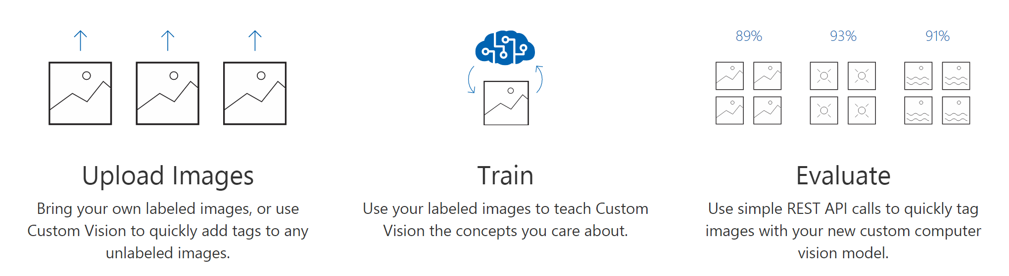
Computer Vision – Custom Vision
Notes:
Custom Vision Service is a tool for building custom image classifiers. It makes it easy and fast to build, deploy, and improve an image classifier. We provide a web interface to upload your images and train.
And a REST API to call your model
One use case of this is if you are walking in the garden at Golden Gate Park and someone wanted to know what type of plant they are looking at. If you build a model with all the different plants in the garden the user would be able to take a picture, and tell it what type of plant is in fron

Slide 15

Face APIs

Slide 16

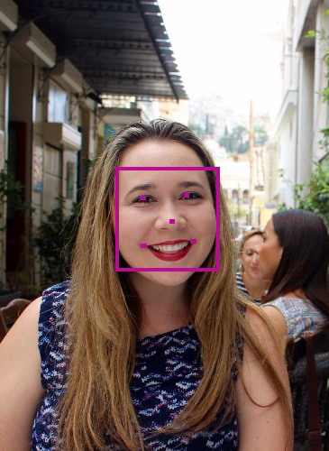

Face Analytics
[
{
"faceId": "5a89cea3-1451-42ff-a875”
"faceRectangle": {
"width": 269,
" height": 269,
"left": 303,
"top": 434
},
"faceLandmarks": {
"pupilLeft": {
"x": 374.1,
"y": 514.6
},
"pupilRight": {
"x": 486,
"y": 506.1
},
. . .
“faceAttributes": {
"age": 31.2,
"gender": "female",
"headPose": {
"roll": -6.2,
"yaw": 8.6,
"pitch": 0
},
"smile": 0.238,
. . .
Notes:
https://www.mymoustache.net

Slide 17
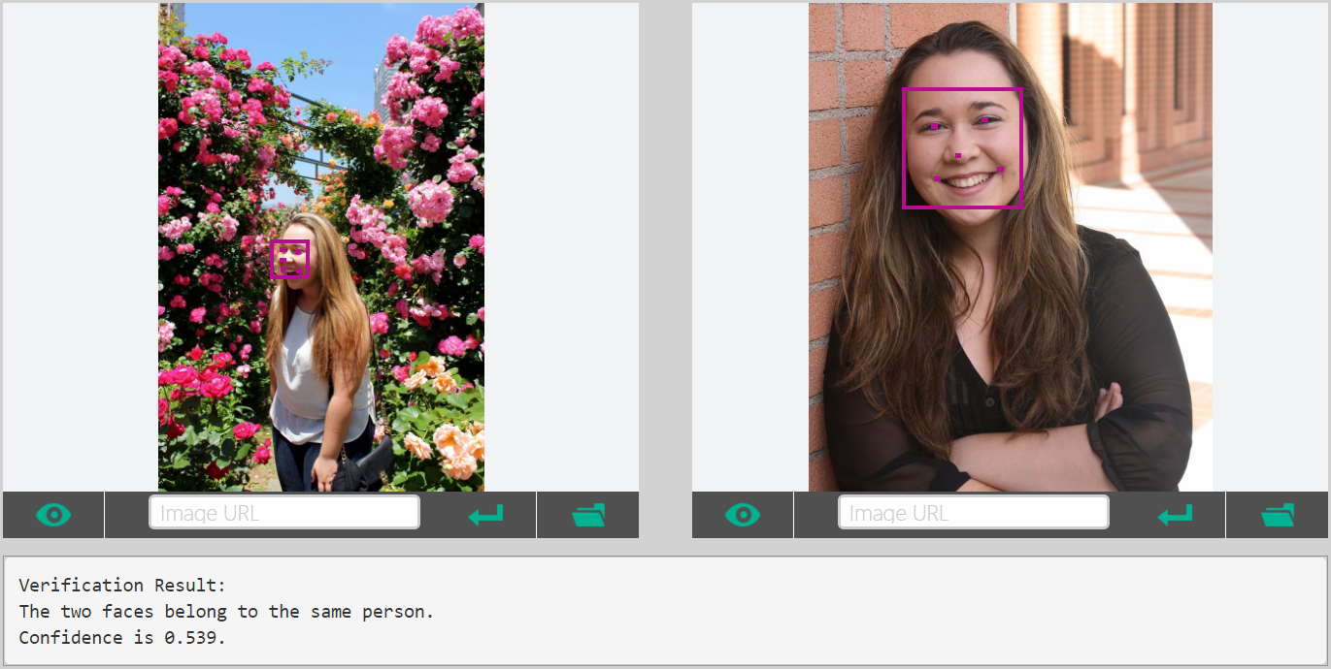
Facial Verification
.
.
.
.
.
.
.

Slide 18


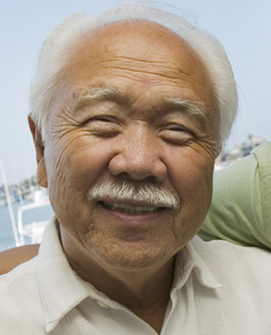

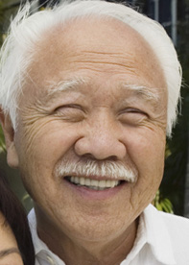

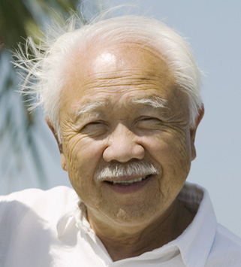





Face API – Grouping
CLUSTERED BY
DETECTED PEOPLE

Slide 19

Speech and Text APIs

Slide 20

Voice Recognition
es-ES
de-DE
fr-FR
en-GB
it-IT
en-US
zh-CN
Converts spoken audio to text
Same backend which powers Cortana
Support for 7 languages at launch

Slide 21
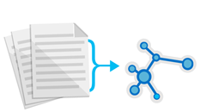



Text Analytics
de-DE
es-ES
fr-FR
en-GB
it-IT
en-US
zh-CN
Sentiment analysis
Key phrase extraction
Language detection for 120 languages
Notes:
Whatnottowatch.azurewebsites.net

Slide 22

LUIS Language Understanding Intelligent Service

Slide 23
Language Understanding Intelligent Service
Lets you understand what your users are saying
Seamless integration with Speech Recognition
A few examples are enough to deploy an application
LUIS learns over time
Define
Concepts
Provide
Examples
Deploy
Active Learning
Notes:
Language Understanding Intelligent Service (LUIS) enables developers to build smart applications that can understand human language and react accordingly to user requests. LUIS uses the power of machine learning to solve the difficult problem of extracting meaning from natural language input, so that your application doesn't have to.

Slide 24
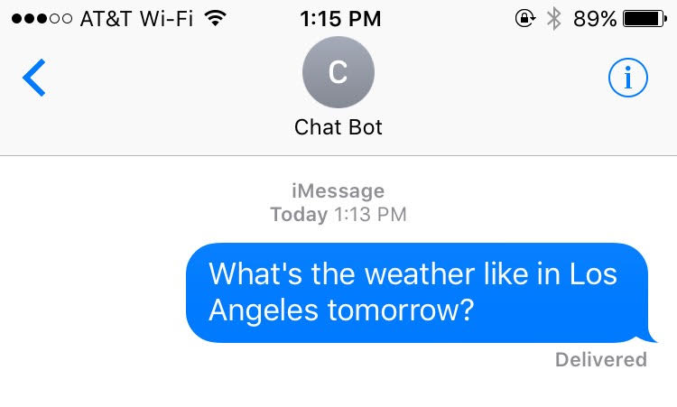
Utterances, Intents, and Entities
function getWeather(location, date)
{
// Do Something
}
Notes:
What is an utterance? An utterance is the textual input from the user, that your app needs to interpret.
What are intents? Intents are like verbs in a sentence. An intent represents actions the user wants to perform
What are entities? If intents are verbs, then entities are nouns. By recognizing the entities that are mentioned in the user’s input, LUIS helps you choose the specific actions to take to fulfill an intent.
Has anyone used LUIS before?
Can someone tell me what the Utterances, intents, and entities are?
Awesome, Now we are going to look at a bot that uses multiple APIs and puts them all together with Murphy

Slide 25

Cognitive Services
Combine APIs to Make Even Smarter Apps
Notes:
Murphy is an experiment running on Azure built with the Chatbot framework
It is using Microsoft Cognitive Services, LUIS, and Bing search.
You can chat with Murphy using Skype and ask it hypothetical "what if ..."

Slide 26
Workshop
microsoft.com/cognitive
Start coding
Lets see it in action!

Slide 27
What is Node.js
Not a programming language!
Not a framework!
Runtime environment for building server side applications
Large ecosystem of open source libraries or “packages”
Node Package Manager (NPM)

Slide 28
What is Express.js
Lightweight web application framework for Node
Helps manage your code architecture, requests, and routing

Slide 29
What is Pug
Template engine for Express
Easier to design HTML pages
Template converted to HTML and sent to client at runtime
Renamed from Jade

Slide 30
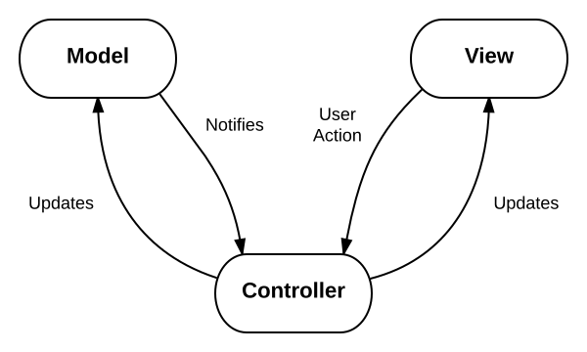
Lets take a look at the code
This architecture pattern is called MVC and is very popular for web applications
Model: The data for your application
View: The physical pages and layout of your application
Controller: The business logic of your application

Slide 31
Install the Prereqs
Install Node.js at nodejs.org/en/downloads
If you have a Mac “brew install node” from the CLI
Install a text editor like Visual Studio Code (works on PC, Mac, or Linux) at code.visualstudio.com
Any text editor you already have will work

Slide 32
Download or clone the repo
Aka.ms/CogServDemo
From the ‘node/cogServ/’ directory
‘npm install’
Windows: ‘set DEBUG=cogServ:* & npm start’
MacOS/ Linux: ‘DEBUG=cogServ:* npm start’
Navigate to http://localhost:3000 in your browser
FYI- it’s not supposed to do anything yet!

Slide 33
Create a Custom Vision Model
Navigate to customvision.ai and log in
Create a new Custom Vision project and upload the images from the ‘node/cogServ/VisionTrainingImages’ folder
Add a tag to the photos from each respective folder

Slide 34
Setup Environment Variables
Add a .env file in the root directory
Copy the Contents of the .env.sample file and add in your keys from Custom Vison Service
PREDICTION_URL=<Your key here>
PREDICTION_KEY=<Your key here>
Note: You don’t need to put your keys in quotes, just paste them as is!

Slide 35
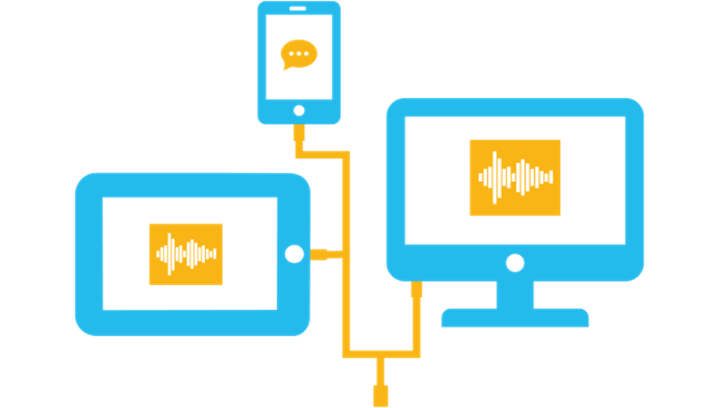
Add Cognitive Services APIs to Your Own Apps
Get subscription key
Make API call
Parse JSON response
Do something with the results

Slide 36
Justine.Cocchi@Microsoft.com
@JustineCocchi

